Slide 1

本此工作：
1>了解了K8s的主要构成，重点学习了k8s三种 网络层次
2> k8s中的网络带宽管理系统

Slide 2
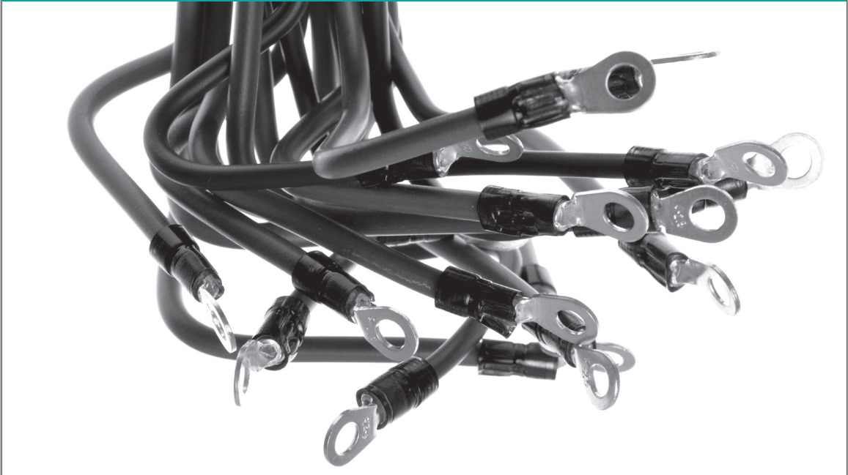
Container Networking
李涛
2020.10.21

Slide 3

背景
Cloud Computing
  Isolation and Multitenancy
    VMs
    Container（lightweight VM）
      Fast startup
      High resource utilization
      Low performance overhead

Slide 4
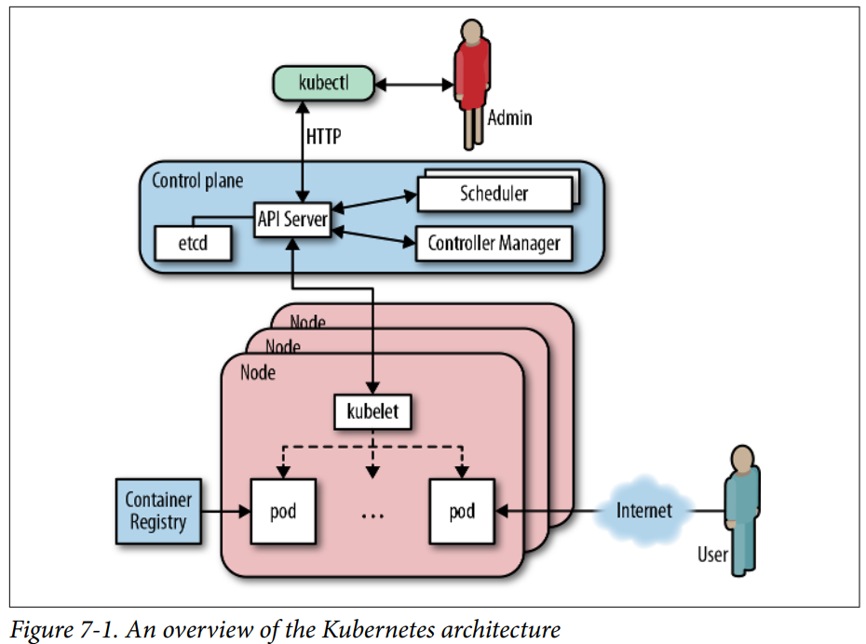
背景
K8s
  - a portable, extensible, open-source plat-
  form for managing containerized workloads and services.

Slide 5
概述
K8s networking 3 fundamental requirements
- Container can communicate with all other containers without NAT
- Nodes can communicate with all containers(and vice versa) without NAT
- The IP container sees itself is the same IP as others see it

Slide 6
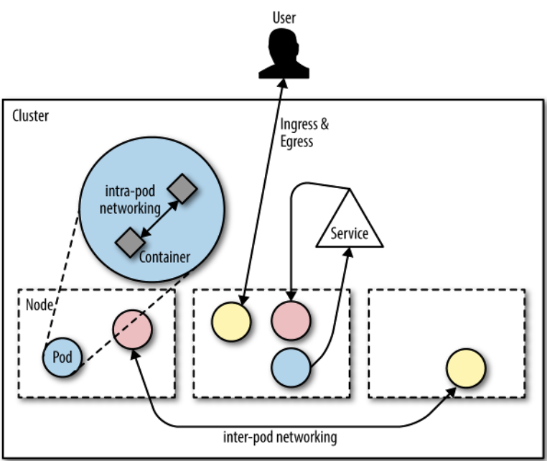
概述
Container Networking
  Intra-Pod Networking
  Inter-Pod Networking
      pod networking
      service networking
    Ingress and Egress
      host network
      (the machines hosting Kubernetes com- ponents such as the kubelet)

Slide 7
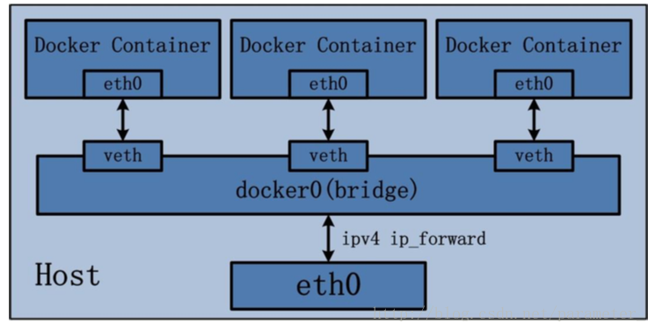
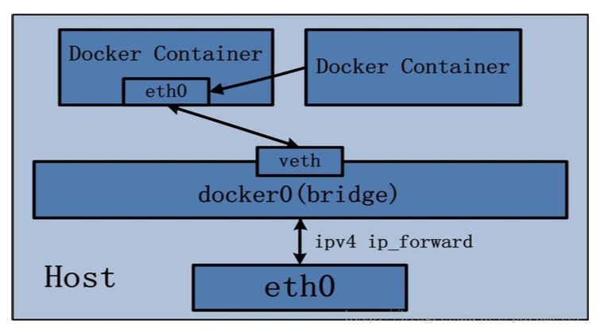
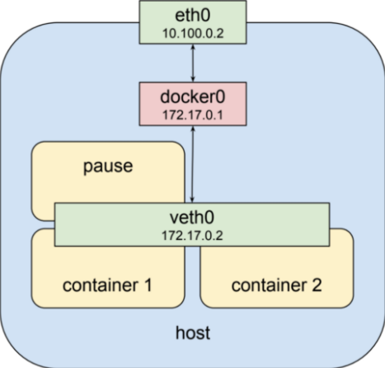
  Intra-Pod Networking
Pause container
- launch first、acquire pod's IP、setup network namespace
Share network namespace
- infra container has bridge mode networking and other cons join this namespace via container mode
networking
+
=>
Bridge mode networking
container mode networking

Slide 8
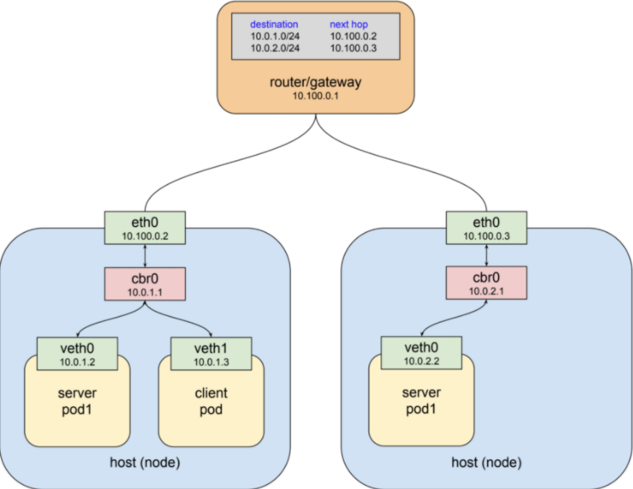
  Inter-Pod Networking
Pod network
- pods directly communicate with other pods
    Access the Pod's services as pod IP + containerPort
return

Slide 9
  Inter-Pod Networking
Pod network
- pods directly communicate with other pods
    Access the Pod's services as pod IP + containerPort
Challenges
- A service often has multiple pods. How to determine which pod's IP to access?
- Pod is often scheduled for a variety of reasons, after scheduling pod's IP will change……

Slide 10
  Inter-Pod Networking
Service network
- service
    A set of pods that work together and the pod group that makes up the Service is defined by a label selector
    Provide a stable virtual IP (Cluster IP)for a set of pods
    Endpoint: a resource object stored in etcd, record the access addresses of all pods for a service
    The Pod under the service in the Cluster can be accessed by the Cluster IP:Port

Slide 11
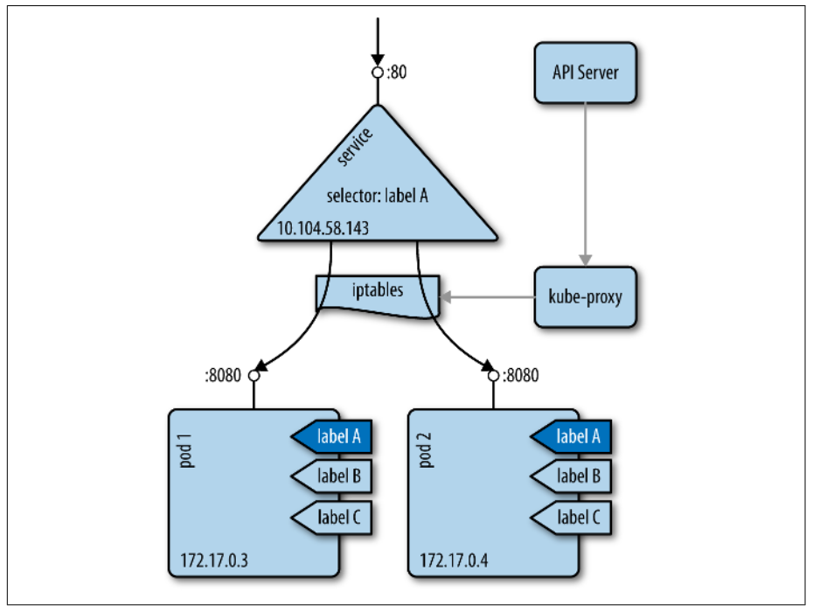
  Inter-Pod Networking
Service network
- service

Slide 12
  Inter-Pod Networking
Service network
- service
Challenges
- A service often has multiple pods. How to determine which pod's IP to access?
√ Pod is often scheduled for a variety of reasons, after scheduling pod's IP will change……

Slide 13
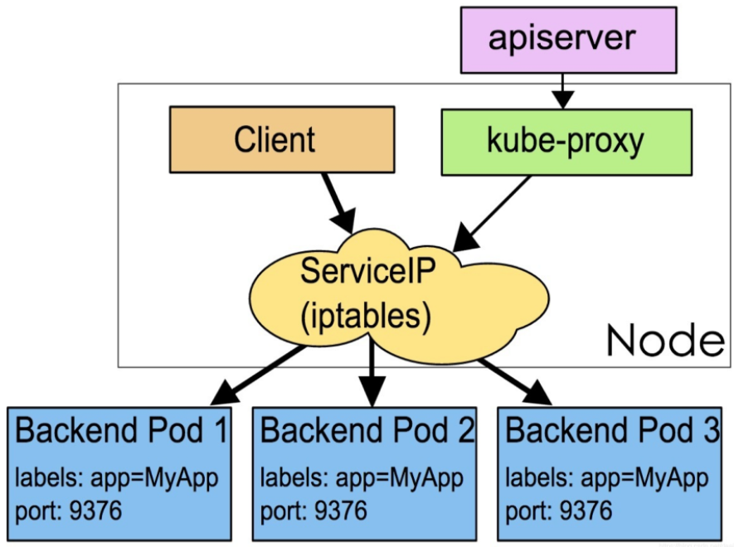
  Inter-Pod Networking
Load balancer--Kube-proxy
  iptable mode
  random

Slide 14
  Inter-Pod Networking
Load balancer--Kube-proxy
  iptable mode
  random
Challenges
√ A service often has multiple pods. How to determine which pod's IP to access?
√ Pod is often scheduled for a variety of reasons, after scheduling pod's IP will change……

Slide 15
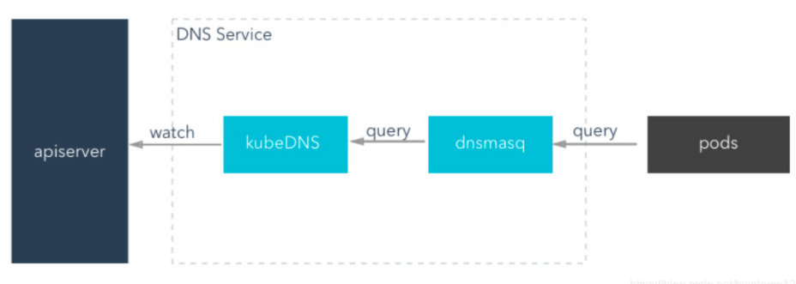
  Inter-Pod Networking
Service discovery--Kube-DNS
  Similarly to DNS ,Service name + IP

Slide 16
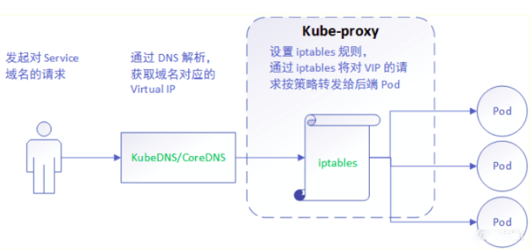
  Inter-Pod Networking

Slide 17
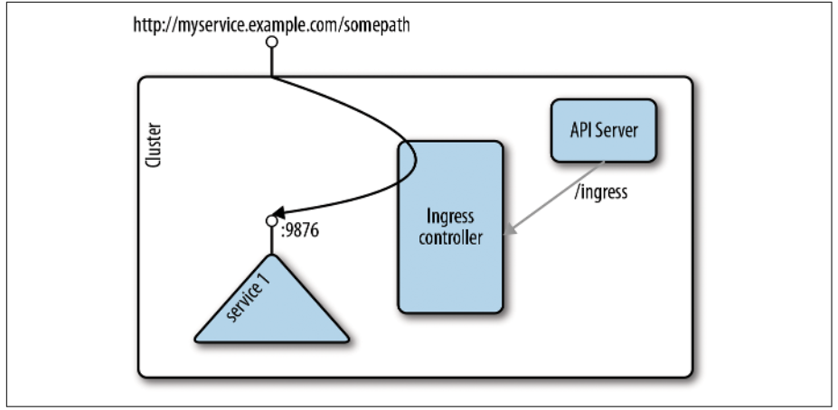
  Ingress and Egress
Ingress
    Ingress resource
      an API object,define rules for forwarding requests to a service(http)。
    Ingress controller
      To realize the reverse proxy and load balancing procedure
      Parsing ingress defined rules, according to the configuration rules to implement forward re-quests.

Slide 18
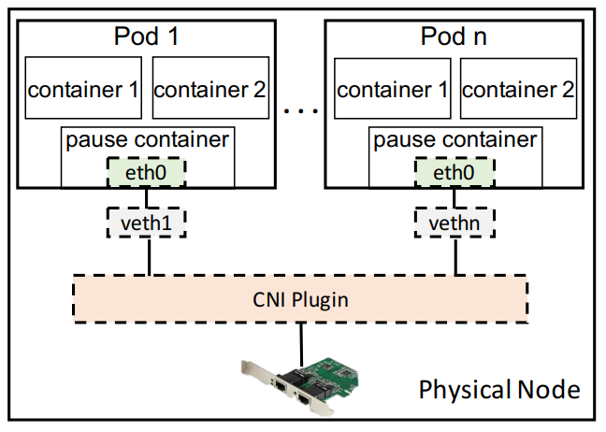
  NBWGuard:network bandwidth manager
Background
- Networking between pods in Kubernetes is supported with plug-ins
- It doesn’t support network bandwidth management
      we cannot maintain the network fair share among pods with the same priority
      we cannot guarantee the network bandwidth allocation to specifc pods running network or storage I/O intensive workloads
link

Slide 19
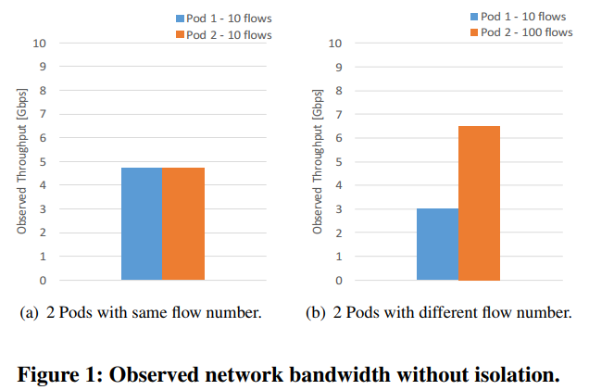
  NBWGuard:network bandwidth manager
Background
return

Slide 20
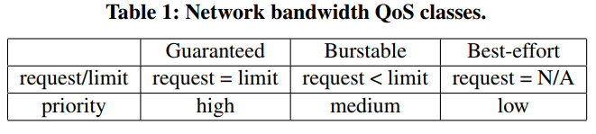
  NBWGuard:network bandwidth manager
Design
- overview
    Prioritize the pod based on the size of the required network resources
    The unused network bandwidth of high priority pods is dynamically shifted to the low priority pods.

Slide 21
  NBWGuard:network bandwidth manager
Design
- 3 QoS classes
    Guaranteed: each pod has a guaranteed bandwidth and one dedicated queue.
    Burstable: Each pod has a guaranteed minimum band-width and a maximum bandwidth.
    Best-effort:They can only use the unused network band-width left by Guaranteed pods and Burstable pods

Slide 22
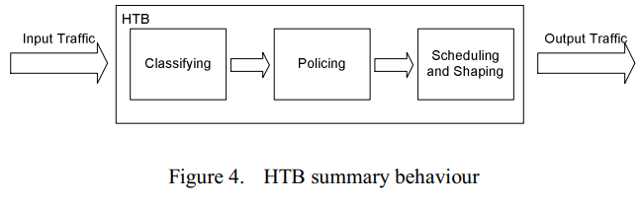
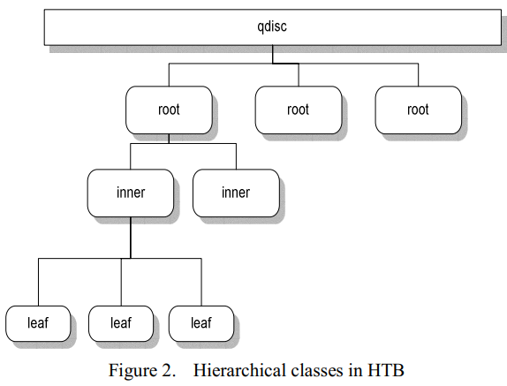
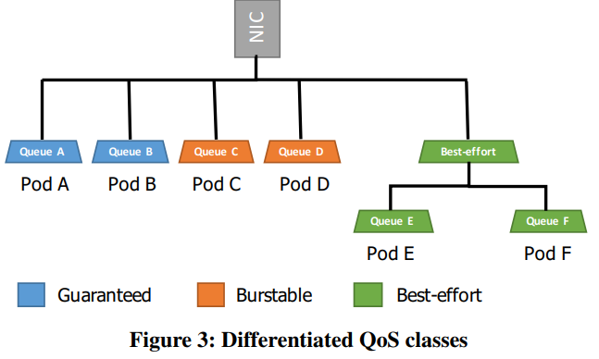
  NBWGuard:network bandwidth manager
Design
- HTB(Hierarchical Token Bucket)
    Classfying

Slide 23
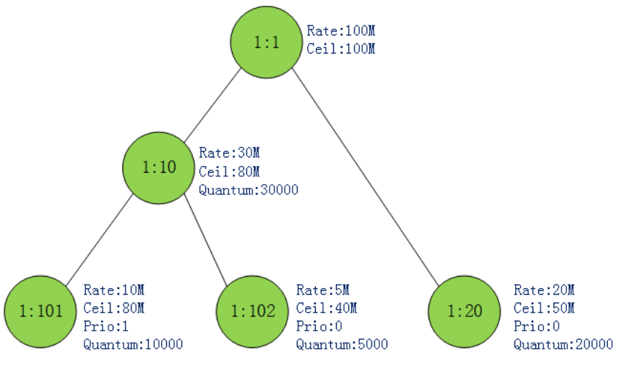
  NBWGuard:network bandwidth manager
Design
- HTB(Hierarchical Token Bucket)
    Policiing
      Limit traffic、share bandwitdth
      prio、rate、ceil、quantum

Slide 24
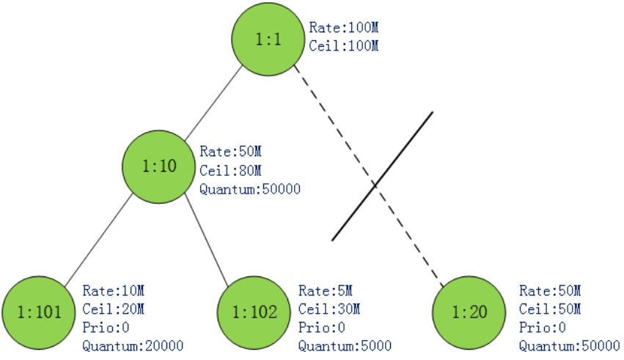
  NBWGuard:network bandwidth manager
Design
- HTB(Hierarchical Token Bucket)
    Policiing
CAN_SEND:
MAY_BORROW:
CANT_SEND:

Slide 25
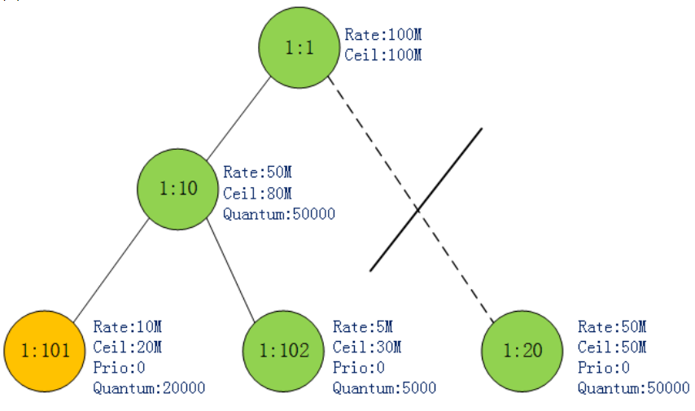
  NBWGuard:network bandwidth manager
Design
- HTB(Hierarchical Token Bucket)
    Policiing
CAN_SEND:
MAY_BORROW:
CANT_SEND:

Slide 26
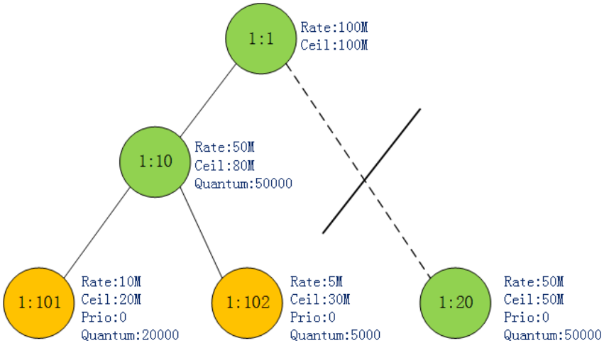
  NBWGuard:network bandwidth manager
Design
- HTB(Hierarchical Token Bucket)
    Policiing
CAN_SEND:
MAY_BORROW:
CANT_SEND:

Slide 27
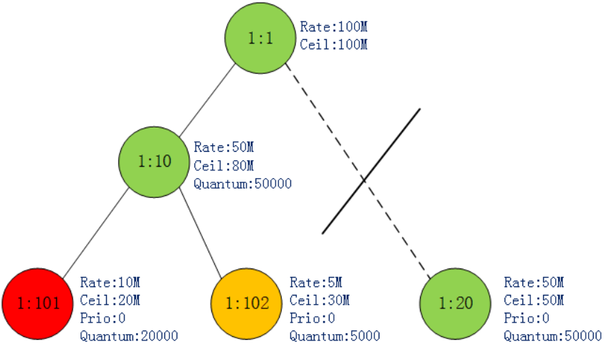
  NBWGuard:network bandwidth manager
Design
- HTB(Hierarchical Token Bucket)
    Policiing
CAN_SEND:
MAY_BORROW:
CANT_SEND:

Slide 28
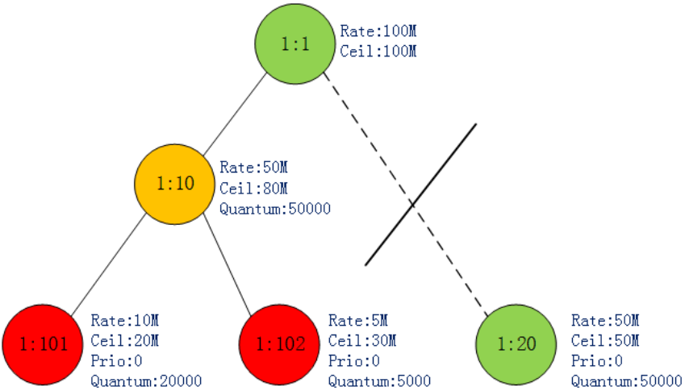
  NBWGuard:network bandwidth manager
Design
- HTB(Hierarchical Token Bucket)
    Policiing
CAN_SEND:
MAY_BORROW:
CANT_SEND:

Slide 29
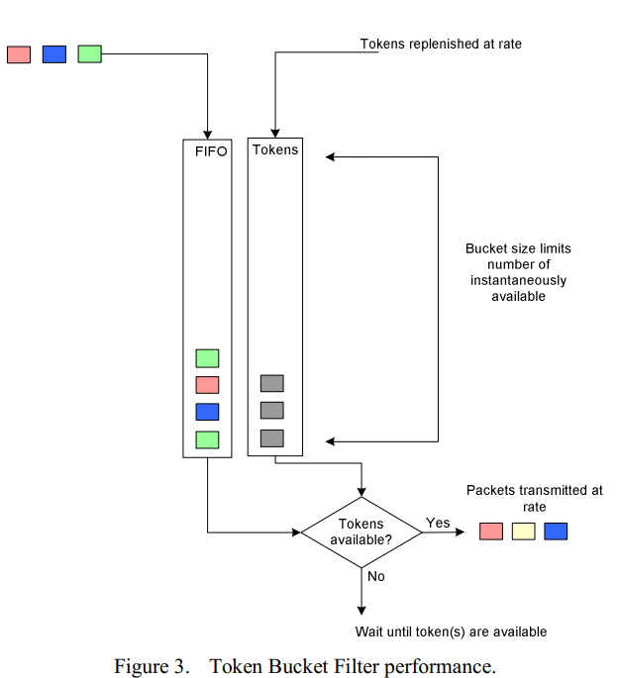
  NBWGuard:network bandwidth manager
Design
- HTB(Hierarchical Token Bucket)
    Scheduling and Shaping
      TBF
      control traffic rate

Slide 30
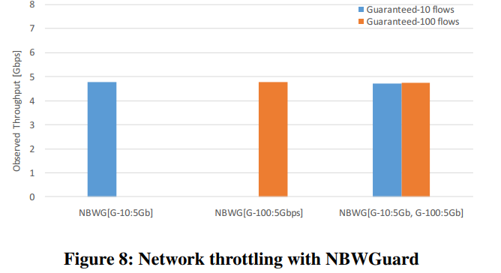
  NBWGuard:network bandwidth manager
Result
- Network Bandwidth Limiting
link

Slide 31
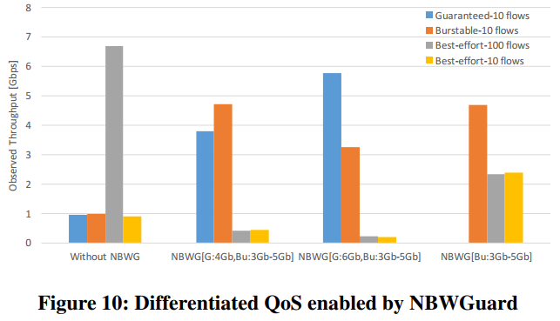
  NBWGuard:network bandwidth manager
Result
- Differentiated QoS Classes

Slide 32


